Slide 1
Lab 09. OOP
Jack . Lin 2017/04/26

Slide 2
Hw.7
String Compare
水果順序

Slide 3
Object-Oriented Programming
Class
Member : Data, Function
Public , Private(Default) , Protected
Encapsulation, Inheritance, Polymorphism

Slide 4
Constructor & Destructor
Class with constructor and destructor
Constructor and Destructor names same as class
No type before the constructor/destructor
No parameter taken in destructor

Slide 5
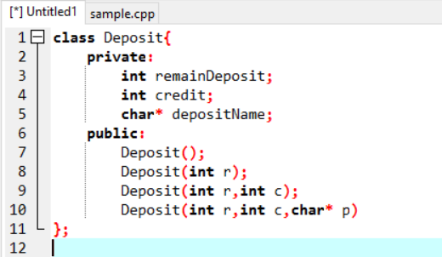
Function overloading
Function have same name with different parameter
Ex. The constructor of a class

Slide 6
Practice: PERSONAL BANKING SYSTEM
Define a class that have private account balance
Can save money and withdrawals

Slide 7
Static vs. Instance MEMBER
Static variable or function
Like global variable
Can access without class
Why Static ?
Access static private variable with static function
Ex. Number of Array fixed ?

Slide 8
Copy Constructor
How to copy a object ?
Copy constructor
Deep copy and shallow copy

Slide 9
Practice: Personal Banking System(Cont.)
Requirement:
The remain deposit should be private ?
Why private ? Encapsulation !
You cannot change your deposit balance directly

Slide 10
Practice: Personal Banking System(Cont.)
Input : initial deposit and options
First line : initial deposit
Every line Except first(option):
1 : show the remain balance
2 : show the history record
3 : take second parameter as savings
4 : take second parameter as withdrawals
5 : cancel the account

